Slide 1
AI-Augmented Software Development Life Cycle SEZG534
Akshaya Ganesan
CSIS, WILP

Slide 2
Contact Session: 3 - Foundations and Paradigm Shift

Slide 3

Q and A
List the major shifts in SE?
Dev effort is no longer the bottleneck,
Roles are less siloed (spec author, reviewer, operator blur),
Decisions are less "hard to change" since regenerating code is cheap,
Accountability is foggier when AI authors artefacts,
Outcomes are probabilistic, not guaranteed.

Slide 4
Shift 1: Dev effort is no longer the bottleneck
Earlier, scarcity of dev effort drove practices like MVP scope-cutting, UX-first design, and rigorous prioritization. If implementation effort drops near zero, how should you think about Software Engineering now?
Example 1: MVP Scope-Cutting vs. Parallel Exploratory Prototypes
Example 2: Design Docs for Human Coordination vs. Design Docs as Machine Specifications

Slide 5
Shift 2: Roles are less siloed
Earlier, clear handoffs defined roles (PM writes PRD ➔Dev writes code ➔QA tests ➔SRE deploys). How should you think about job roles and team structures now?
Example 1: The Product Manager / Developer Blur or The Developer / QA / SRE Blur

Slide 6
Shift 3: Decisions are less "hard to change"
Earlier, architectural decisions were treated as one-way doors because refactoring took months. How should you think about software architecture when code regeneration is virtually free?
Example 1:The Rise of "Disposable Microservices“
Code is now an abundant, disposable commodity

Slide 7
Shift 4: Accountability is foggier when AI authors artefacts
"Earlier, 'You built it, you run it' established clear human accountability. When AI generates 80% of code, tests, and PRDs, who is accountable when things break, and how do we enforce governance?“
Example 1: The Security Vulnerability / Supply Chain Attack
Example 2: Compliance & Algorithmic Auditability

Slide 8
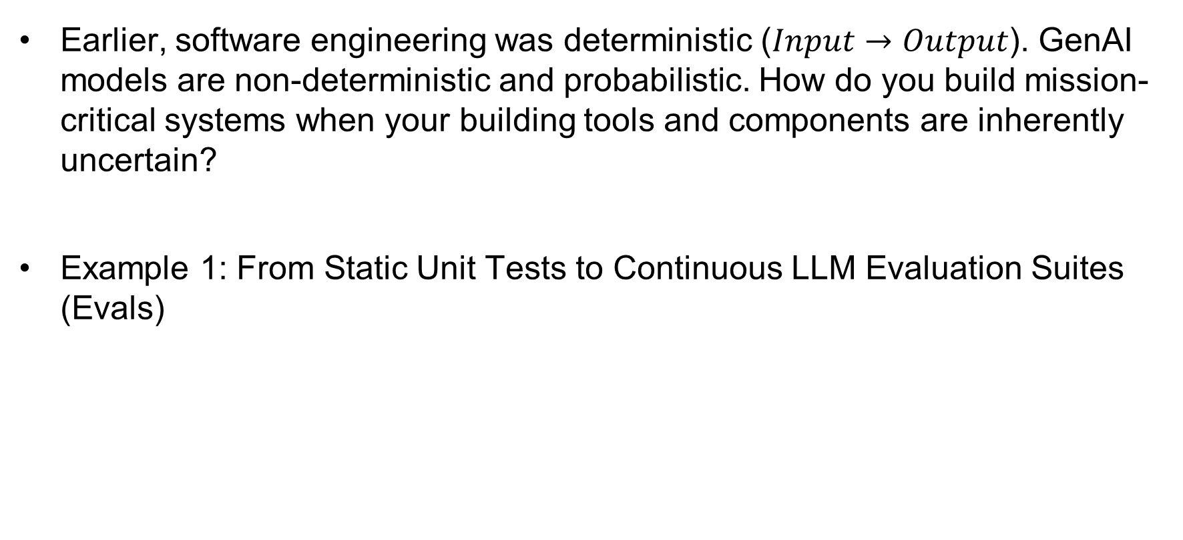
Shift 5: Outcomes are probabilistic, not guaranteed
Earlier, software engineering was deterministic ($Input→Output$). GenAI models are non-deterministic and probabilistic. How do you build mission-critical systems when your building tools and components are inherently uncertain?
Example 1: From Static Unit Tests to Continuous LLM Evaluation Suites (Evals)

Slide 9
RETHINKING SOFTWARE ENGINEERING
RETHINKING SOFTWARE ENGINEERING ??
If source code can be produced cheap and at scale,
What is the enduring value proposition of Software Engineers

Slide 10
RETHINKING SOFTWARE ENGINEERING
The future of software engineering is shifting from writing software to designing, orchestrating, verifying, and governing intelligent systems.

Slide 11
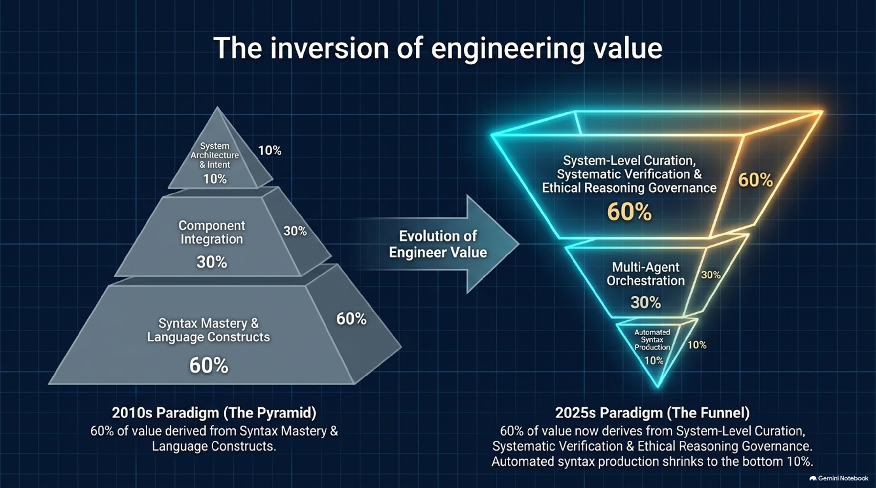
Inversion of engineering value
Reference:Rethinking Software Engineering for Agentic AI Systems, https://arxiv.org/html/2604.10599v1

Slide 12
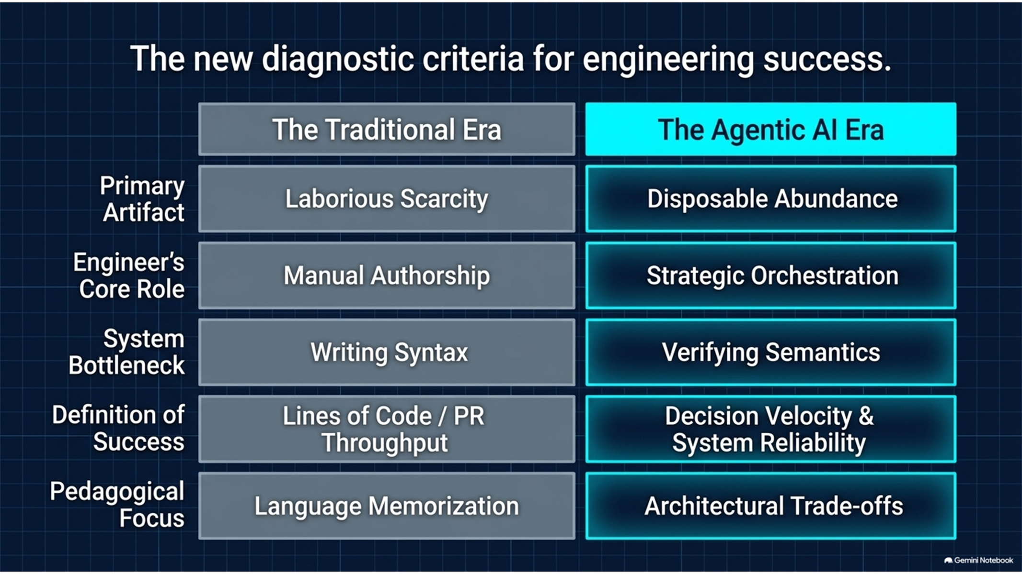
Reference:Rethinking Software Engineering for Agentic AI Systems, https://arxiv.org/html/2604.10599v1

Slide 13
The New Core Competencies of Software Engineering
Intent Articulation and Architectural Control
Systematic Verification and Quality Assurance
Multi-Agent Orchestration
Human Judgment and Accountability
Reference:Rethinking Software Engineering for Agentic AI Systems, https://arxiv.org/html/2604.10599v1

Slide 14
Transition to AI Augmented SDLC
The transition to AI-augmented engineering requires coordinated transformation across four tightly coupled dimensions:
Education: From Syntax Mastery to Systems Curation
Tooling: Infrastructure for Orchestration and Verification
Processes: Verification-First and Human-in-the-Loop Lifecycles
Professional Practice: Roles, Metrics, and Governance

Slide 15
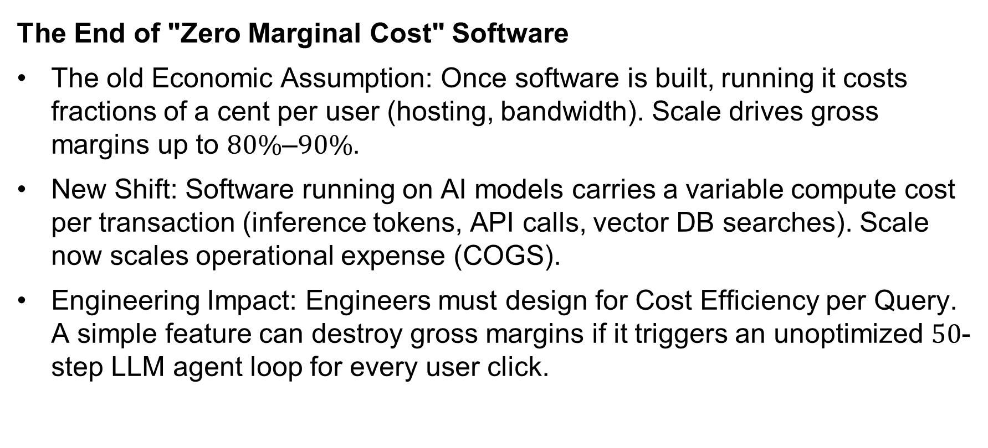
Shift in software economics - 1
The End of "Zero Marginal Cost" Software
The old Economic Assumption: Once software is built, running it costs fractions of a cent per user (hosting, bandwidth). Scale drives gross margins up to $80\%\text{–}90\%$.
New Shift: Software running on AI models carries a variable compute cost per transaction (inference tokens, API calls, vector DB searches). Scale now scales operational expense (COGS).
Engineering Impact: Engineers must design for Cost Efficiency per Query. A simple feature can destroy gross margins if it triggers an unoptimized $50$-step LLM agent loop for every user click.

Slide 16
Shift in software economics - 2
The Shift from "Build vs. Buy" to "Token Cost vs. Human Labor“
Old Economic Assumption: Software cost trade-offs were evaluated as internal developer salary cost (Build) versus external vendor subscription fees (Buy).
The baseline equation shifts to Inference Cost + Human Verification Cost vs. Full Human Execution Cost.

Slide 17
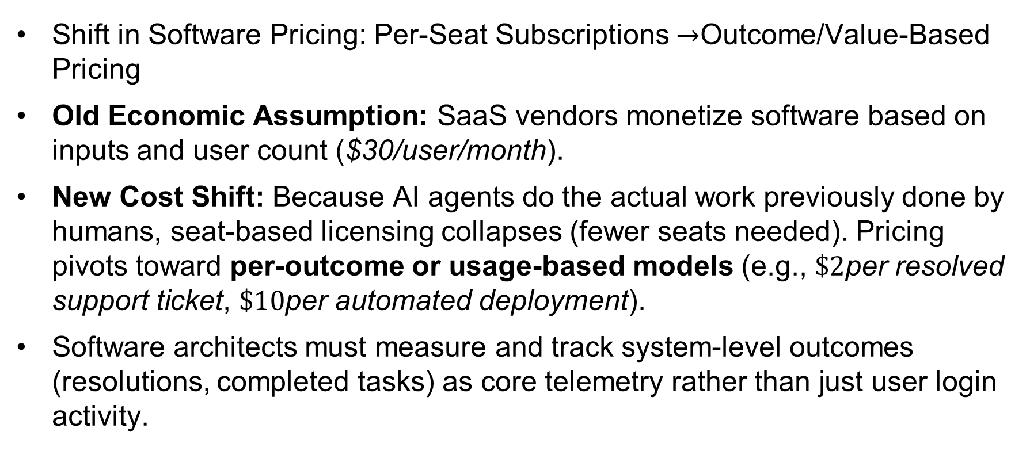
Shift in software economics - 3
Shift in Software Pricing: Per-Seat Subscriptions $→$Outcome/Value-Based Pricing
Old Economic Assumption: SaaS vendors monetize software based on inputs and user count ($30/user/month).
New Cost Shift: Because AI agents do the actual work previously done by humans, seat-based licensing collapses (fewer seats needed). Pricing pivots toward per-outcome or usage-based models (e.g., $\$2$per resolved support ticket, $\$10$per automated deployment).
Software architects must measure and track system-level outcomes (resolutions, completed tasks) as core telemetry rather than just user login activity.

Slide 18
Risks across the software development lifecycle (SDLC)
Code Quality & Security Vulnerabilities
Plausible but Insecure Code
Hallucinated Package Dependencies (Supply Chain Attacks)
Missing Edge Cases in Generated Tests
Architectural Drift or Unchecked Tech Debt ("Code Slop")
High-Volume "Code Bloat“
Context Blindness
Human Factor & Cognitive Risks
Reviewer Fatigue
Atrophy of Fundamental Skills
Legal, IP, and Compliance Exposure
Economic & Operational Risks

Slide 19
References
Rethinking Software Engineering for Agentic AI Systems, https://arxiv.org/html/2604.10599v1

Slide 20
Thank you

